Slide 1
AI AND ML BASED ANALYSIS OF ENVIRONMENTAL FACTORS
GROUP NO. 29
R&D PROJECT
Final Presentation

Slide 2
Project Mentors
Dr. Mohd.Anul Haq
Dr. Nidhi Chahal
Mr. Gazi Rahman
Mr. Prasanth Baral
Student Mentors

Slide 3
Group Members
⦿Sherry Sharma U101116FCS287
⦿Desu Lohith U101116FEC159
⦿V Jashwanth U101116FCS151
⦿Nair Tejas Deepak U101116FCS280
⦿Javid Akhtar U101116FCS269

Slide 4
Objectives
Analysis of interrelationships among Snow cover, Vegetation, Temperature.
Time series forecasting of environmental factors using AI & ML methods

Slide 5
Rationale of the Work
Modelling of environmental parameters like snow cover, temperature, vegetation
Improving the accuracy of LSTM model using different techniques
Forecasting the individual parameter using different multiple parameters

Slide 6
Methodology
Input dataset
Training the model using LSTM
Forecasting features
Step 1
Step 2
Step 3
Step 4
Step 5
Hyper parameters tuning
Testing the model using LSTM

Slide 7
In this project we have compared the performance of Artificial Neural Networks(ANN) and Long Short Term Memory(LSTM) for time series analysis and forecasting of environmental factors for Himachal Pradesh with given dataset.

Slide 8
Phase 1
In the first phase of project we have forecasted each parameter individually using ANN and LSTM.
We calculated R² values to find the accuracy of two models.

Slide 9
Artificial Neural Network
ANN is a computational model based on the structure and function of biological neural networks.
ANN learns from data sets using random function approximation tool which help to estimate the cost effective methods for arriving at solution.
ANNs have three layers of interconnected neurons
Input layer
Hidden layer
Output layer

Slide 10
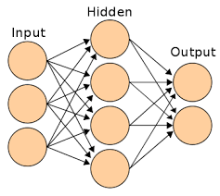
ANN architecture
src: https://www.analyticsvidhya.com/blog/2014/10/ann-work-simplified/

Slide 11
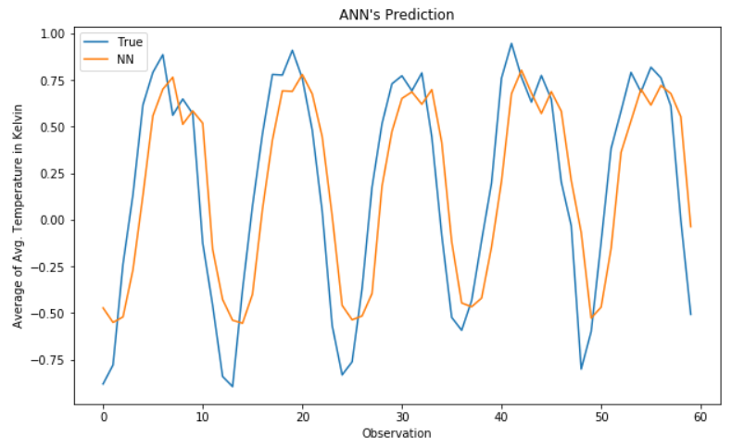
ANN Temperature Forecasting
R² value = 0.681

Slide 12
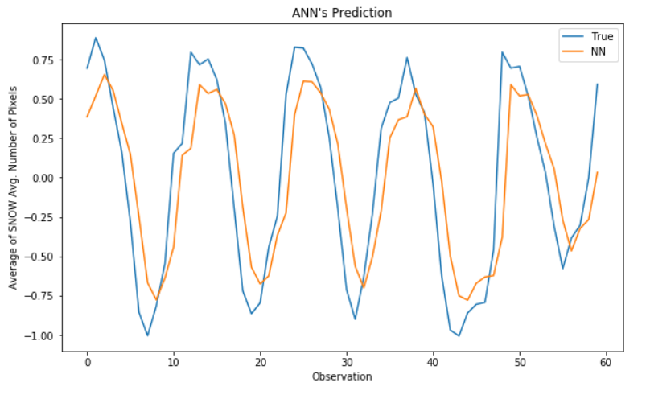
ANN Snow cover
Forecasting
R² value = 0.66

Slide 13
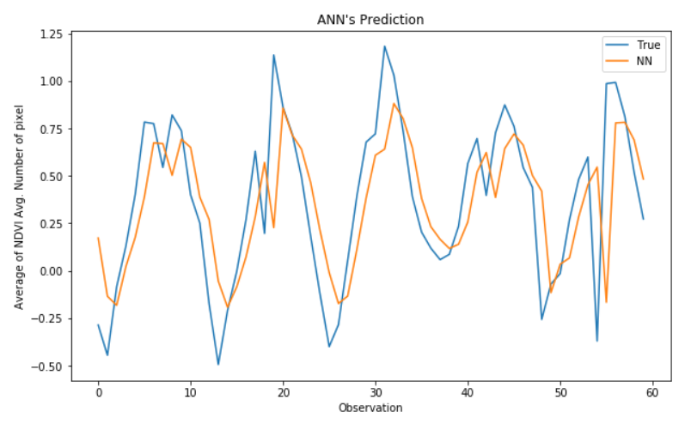
ANN NDVI
Forecasting
R² value = 0.404

Slide 14
Long Short Term Memory
LSTM is a kind of Recurrent Neural Network capable of learning long term dependencies.
It has a chain structure that contains four neural networks and different memory blocks called cells.
Information is retained by the cells and the memory manipulations are done by the gates.
There are three gates:
1. Forget Gate
2. Input gate
3. Output gate

Slide 15
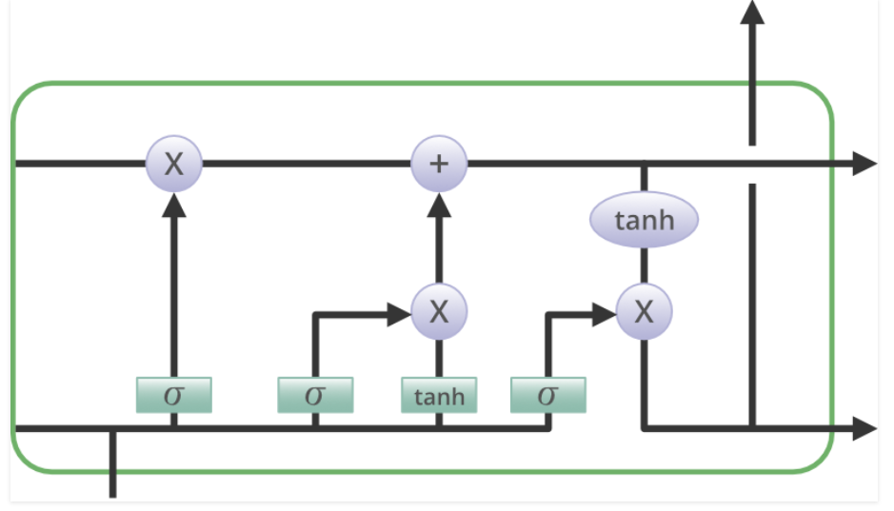
Architecture of LSTM
src:https://www.geeksforgeeks.org/deep-learning-introduction-to-long-short-term-memory/

Slide 16
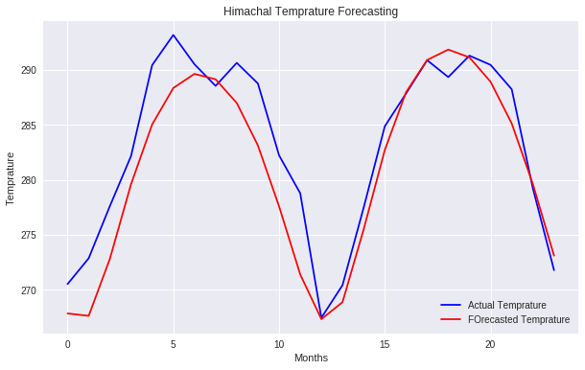
LSTM Temperature Forecasting
R² value=0.89
For ANN 0.681

Slide 17
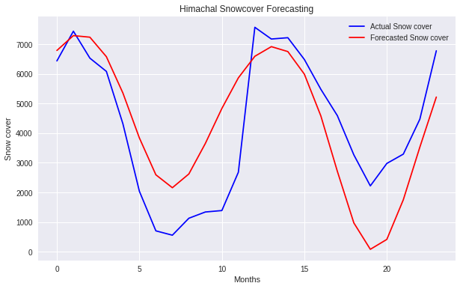
LSTM Snow cover
Forecasting
R² value= 0.674
For ANN 0.66

Slide 18
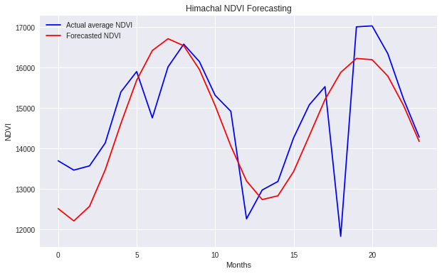
LSTM NDVI
Forecasting
R² value= 0.4871
For ANN 0.404

Slide 19
From the above results we can conclude that LSTM performs better than ANN.
But for Snow cover and NDVI even LSTM was not efficient to consider the model.

Slide 20
Phase 2
To improve the accuracy , we tried the following combinations of data for two input and one output using LSTM method.
Monthly
Seasonal
Yearly

Slide 21
Two input and one output Monthly
The dataset contains parameters which are inter-related to each other.
In order to increase the accuracy of the model we used multiple combinations of these parameters to forecast.

Slide 22
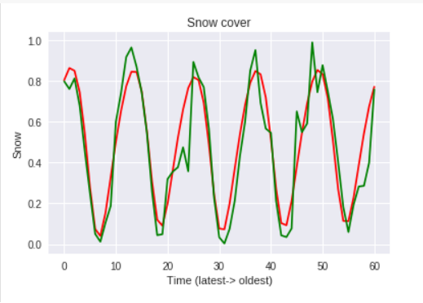
Temperature & Snow cover output
R² value=0.854
(previous R² value= 0.51)

Slide 23
Hyper parameters tuning
To get the accurate values we need to tune set of hyper parameters like number of neurons, optimizer, epochs.
In this case we had tuned the neurons to find the point where the model performs best.
By changing number of neurons may also occurs underfitting and overfitting.

Slide 24
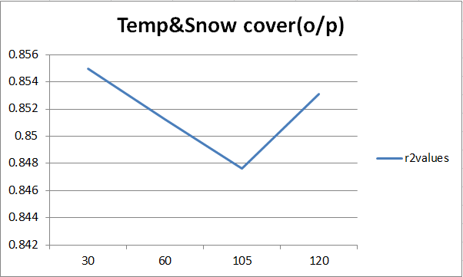
Hyper parameters tuning

Slide 25
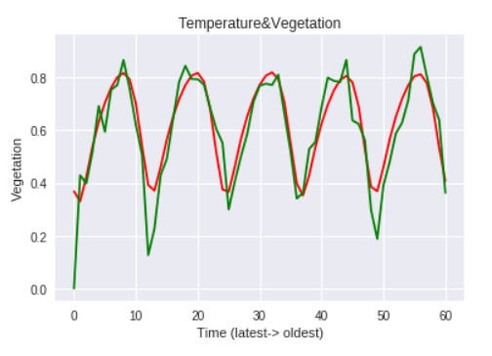
Temperature & NDVI output
R² value=0.794
(previous R² value= 0.487)

Slide 26
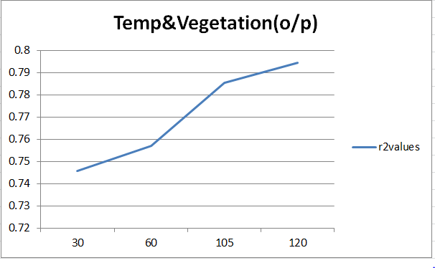
Hyper parameters tuning

Slide 27
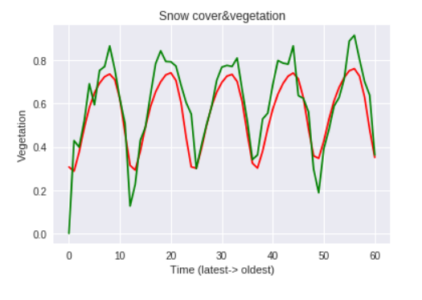
Snow cover & NDVI output
R² value=0.836
(previous R² value= 0.487)

Slide 28
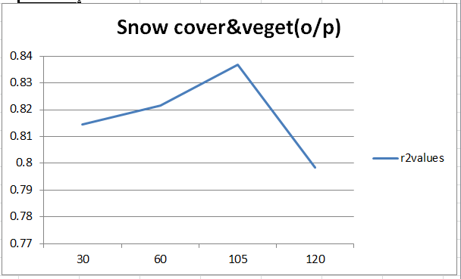
Hyper parameters tuning

Slide 29
Two input and one output
Seasonal
The 3 parameters that we are forecasting are dependent on seasonal variations.
The complete dataset has been divided into four seasons.
In the seasonal dataset we tried different optimizers to get the accurate.

Slide 30
Changing Optimizers
Optimizer | Seasonal Temp & Snow cover | Seasonal Temp & NDVI | Seasonal Snow cover & NDVI
ADAM | 0.95 | 0.89 | 0.92
RMSProp | 0.93 | 0.88 | 0.90
Adamax | 0.91 | 0.68 | 0.61

Slide 31
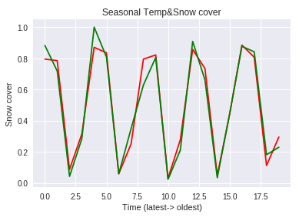
Temperature & Snow cover output
R² value= 0.950.95

Slide 32
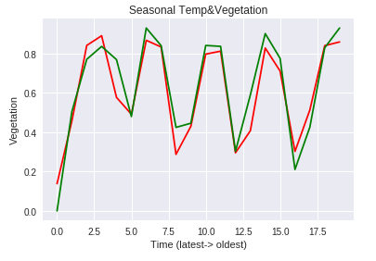
Temperature & NDVI output
R² value=0.89

Slide 33
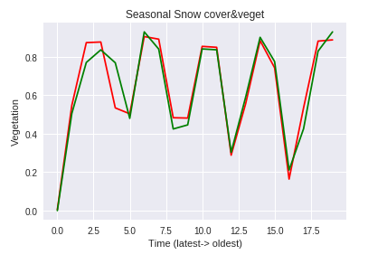
Snow cover & NDVI output
R² value=0.92

Slide 34
Two input and one output
Annual

Slide 35
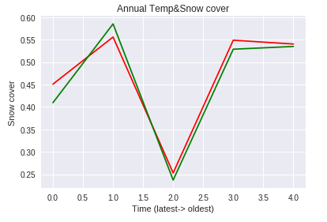
Temperature & Snow cover output
R² value= 0.95

Slide 36
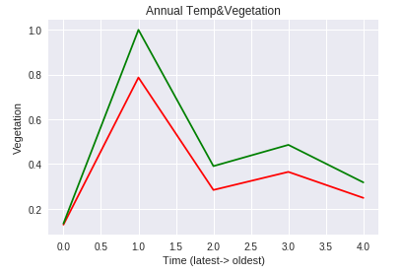
Temperature & NDVI output
R² value= 0.97

Slide 37
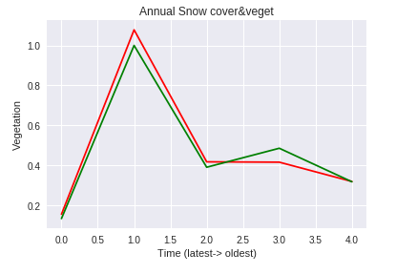
Snow cover & NDVI output
R² value= 0.98

Slide 38
Phase 3
In this phase we implemented the LSTM model to forecast each individual parameter for next seven years.
For forecasting at next time step we applied moving forward window technique.

Slide 39
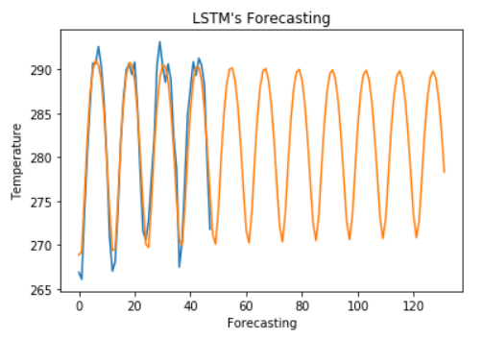
Temperature
forecasting
For 7 years

Slide 40
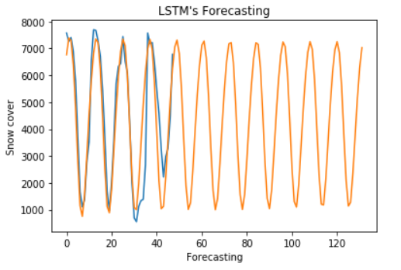
Snow cover forecasting
For 7 years

Slide 41
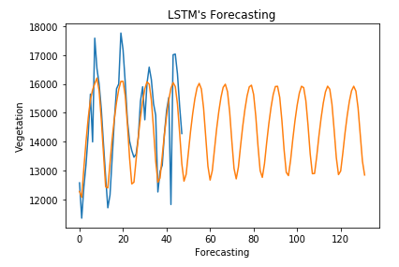
NDVI forecasting
For 7 years

Slide 42
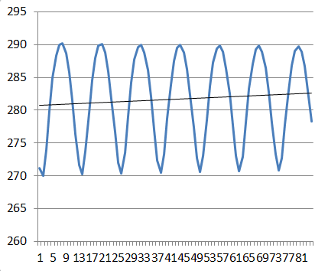
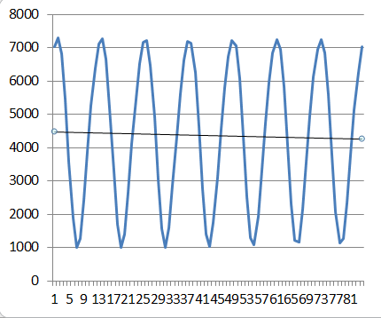
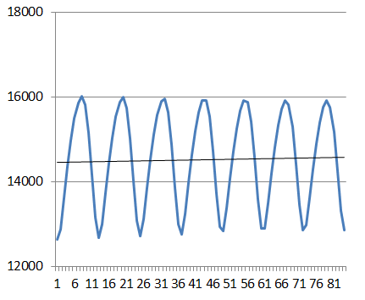
Forecasted trend
Temperature Snow cover Vegetation

Slide 43
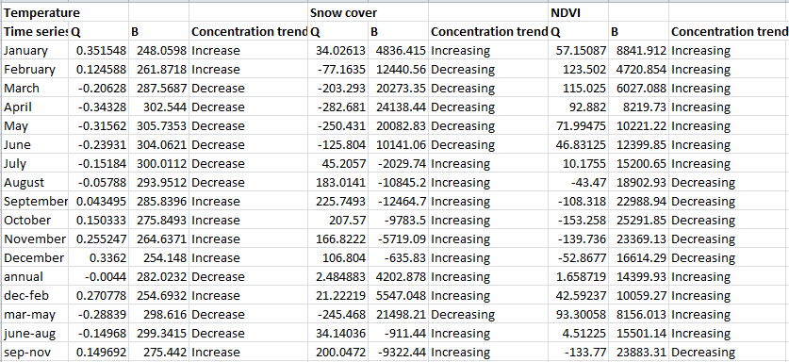
Trend test results for forecasting

Slide 44
We applied mann-kendall trend test and Sen’s slope estimator
for the forecasted values.
The above test results shows confidence factor of greater than 95%

Slide 45
Conclusion
The trends from the forecasted graphs we can say that in coming future the temperature increases and it decreases the snow cover and implies increase in vegetation.
As these three factors are inter-dependent to each other we achieved higher R-square value for multiple combinations when compared to individual parameters.

Slide 46
Timeline
Understanding the scope of forecasting process
Developing the primitive model & Drafting the research paper
Final presentation & research paper completion
Jan 12 - Jan 20
Jan 21-
Feb 20
Feb 21 -
Apr 15
Apr 16 - May 5
April 24 Deadline
Working on methodology
Further improvements & drafting the final report

Slide 47
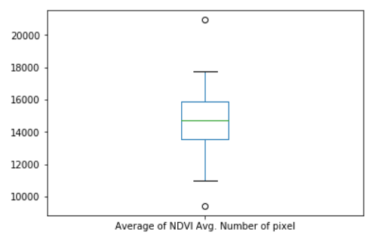
Difficulties faced
In the dataset it contains outliers in NDVI parameter due to which the efficiency of model has been reduced.
We overcome the problem using Boxplot to find out outliers.

Slide 48
Cont..
To find the suitable set of hyper parameters we had tried all possible combinations.
For this we have to train and test the model multiple times without affecting other variables.

Slide 49
Research paper Status
Included all the work and results in the paper with proper citation and references.
It is ready in IJCO (International Journal for climatology) format to submit for review.

Slide 50
Thank You

